Slide 1
OVERVIEW OF UJT, RELAXATION OSCILLATOR, 555 Timer

Slide 2
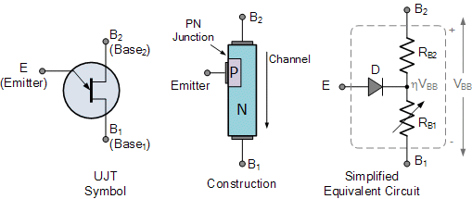

UNI JUNCTION TRANSISTOR (UJT)

Slide 3
OVERVIEW OF UJT:
An UJT is formed from a P-type and the N-type material to create a single junction.
These transistors can be utilized during the switching of the devices to ON/OFF. They doesn’t suit for amplification techniques.
From the name itself, the UJT or uni junction transistor is a semiconductor device that has only one junction.
The UJT has three terminals designated B1, B2 and E.
The base material for a UJT is a lightly doped N-Type Silicon bar with ohmic contacts given at the lengthwise ends. These end terminals are called B1 and B2.
Since the silicon bar is lightly doped, the resistance between B1 and B2 is very high (typically 5 to 10 KΩ).
A heavily doped P-type region is constructed on one side of the bar close to the B2 region.
This heavily doped P region is called emitter and it is designated as E.
Resistance between E & B1 is higher than the resistance between E & B2 because E is constructed close to B2.

Slide 4














UJT Characteristics:
The characteristics of the UJT are as follows:
It requires very low amount of voltage to get triggered.
It is capable of controlling the current pulse.
It consists of the negative value of the resistance.
The cost of this transistor is very low.

Slide 5
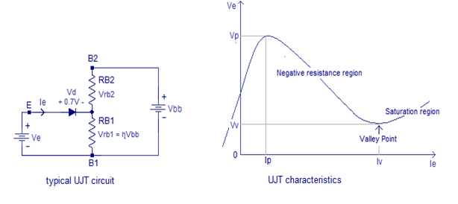











UJT Working & Characteristics
Ve = Vd + V_{Rb1}
Considering the intrinsic stand off ratio η= RB1/(RB1+RB2), the equation becomes
Ve = Vd+ηVbb

Slide 6
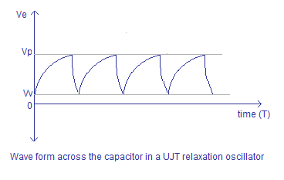








Slide 7
As the current in the UJT tends to increase there can be evident drop in voltage value. Hence this transistor shows the negative characteristics of resistance. This paves the way to make the UJT to work as a relaxation oscillator.
B2 terminal of the UJT is made positive with respect to B1 terminal using the voltage source Vbb.
Emitter terminal E of the UJT is forward biased using the voltage source Ve.
Current starts flowing into the emitter only when the bias voltage Ve has exceeded the forward drop of the internal diode (Vd) plus the voltage drop across RB1 (Vrb1).
This condition can be expressed using the following equation.
Ve = Vd + Vrb1
Considering the intrinsic stand off ratio η= RB1/(RB1+RB2), the equation becomes
Ve = Vd+ηVbb

Slide 8
Working of UJT
A typical silicon diode has a forward voltage drop of 0.7V. When this factor is considered, the equation can be re written as
Ve = 0.7V + ηVbb
This minimum value of the emitter voltage Ve for which the emitter current starts to flow is called the firing voltage of UJT.
As the Ve is increased the emitter current Ie is also increased and the junction behaves like a typical P-N junction.
But the Ve can be only increased up to a particular point called Vp (peak voltage). At this point a considerable amount of emitter current (Ie) flows and a significant number of holes are injected into the junction. These holes are repelled by B2 and attracted by B1.
As a result, the region between emitter(E) and B1 terminal starts saturating by holes and the conductivity of this region starts to increase. This phenomenon of increasing conductivity by the insertion of holes is called conductivity modulation. This increased conductivity reduces RB1 and η.
This results in a condition where emitter current Ie increases and the emitter voltage Ve decreases. This situation is similar to a negative resistance scenario.
This negative resistance region in the UJT characteristics is employed in relaxation oscillators.

Slide 9
UJT RELAXATION OSCILLATOR:
UJT is a transistor with one junction.
This possesses the resistance with negative characteristics.
This makes the UJT to function as an oscillator.
This is an oscillator with the basic resistor and capacitor.
As it is good at switching, it takes minimum value of the nano seconds for switching the devices.

Slide 10
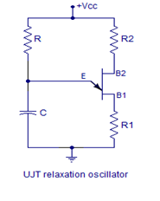
The circuit diagram of a UJT relaxation oscillator is given below.
R1 and R2 are current limiting resistors. Resistor R and capacitor C determines the frequency of the oscillator.
The frequency of the UJT relaxation oscillator can be expressed by the equation,
F = 1/ (RC ln(1/(1-η))
where η is the intrinsic standoff ratio and ln stand for natural logarithm.

Slide 11
When power supply is switched ON, the capacitor C starts charging through resistor R.
The capacitor keeps on charging until the voltage across it becomes equal to 0.7V plus ηVbb.
This voltage is the peak voltage point “Vp” denoted in the characteristics curve. After this point the emitter to RB1 resistance drops drastically and the capacitors starts discharging through this path.
When the capacitor is discharged to the valley point voltage “Vv”, the emitter to RB1 resistance climbs again and the capacitor starts charging.

Slide 12
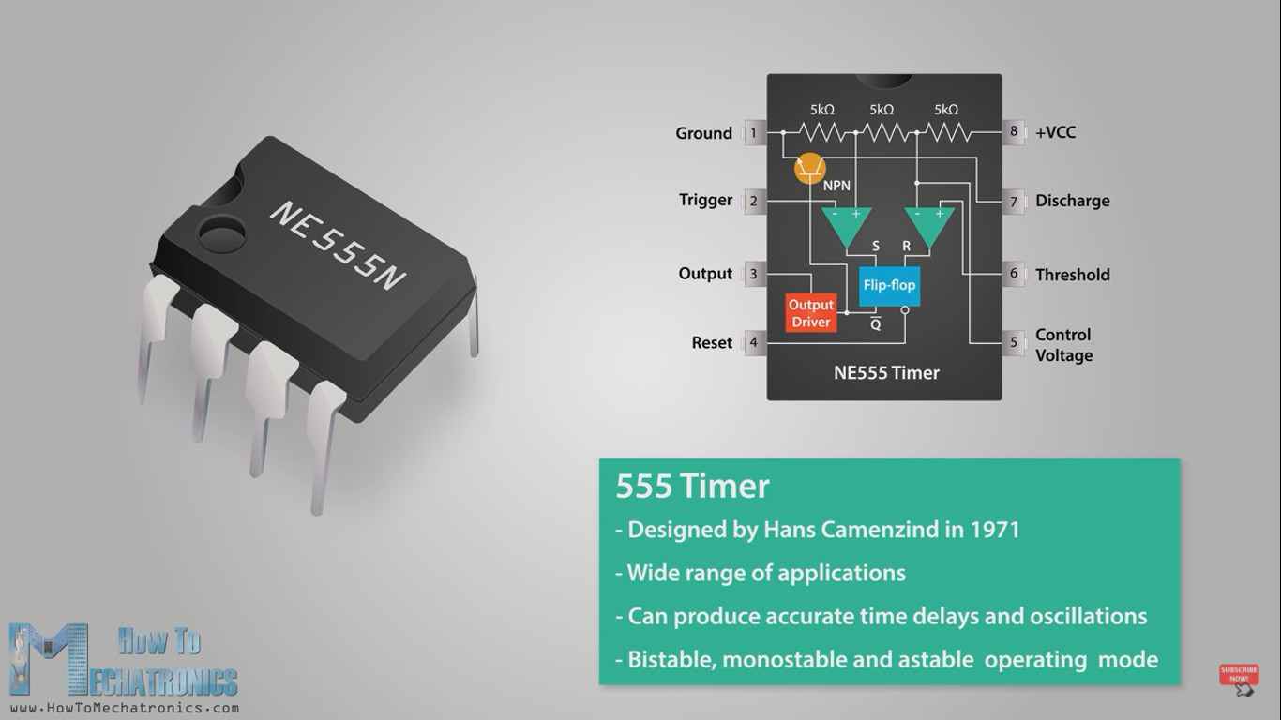
IC 555 TIMER

Slide 13
The 555 Timer
The 555 Timer is one of the most popular
and versatile integrated circuits ever produced.
It is 50 years old and still being used.
It is a combination of digital and analog circuits.
It is known as the “time machine” as it performs a wide variety of timing tasks.

Slide 14
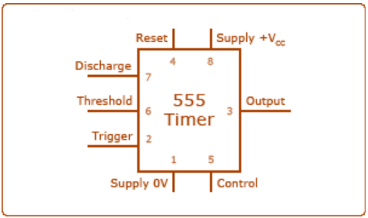
555 Timer Pin Connection

Slide 15
555 Timer Pin Function
PIN 1: Ground – Connect this to ground. Remember to connect all grounds in a circuit together.
PIN 2: Trigger – A short low (less than 1/3 Vcc) pulse on the trigger starts the timer. By connecting this to ground we "turn on" the 555 timer.
PIN 3: Output – During a timing interval, the output stays at +VCC. Can source up to 200mA.
PIN 4: Reset – Forces pin 3 low if pulled to ground.
PIN 5: Control – Can be used to adjust threshold trigger voltage. Not used in our applications. Connect to ground with a .01uF capacitor to eliminate supply noise from Vcc.
PIN 6: Threshold – When threshold crosses above 2/3 Vcc timing interval ends.
PIN 7: Discharge – Connects to ground when output goes low. Controls timing.
PIN 8: Vcc – Power supply. Typical range 4.5v to 16v.

Slide 16
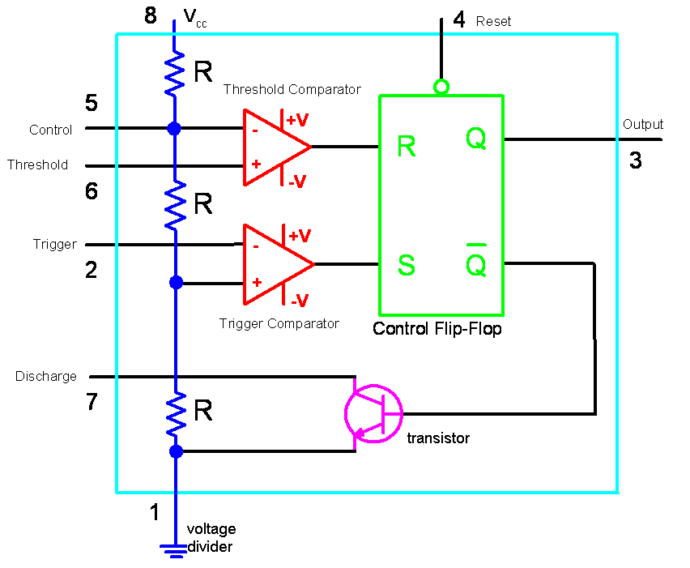
Internal Circuit of 555 Timer

Slide 17
Inside the 555 Timer
The voltage divider (blue) has three equal 5K resistors. It divides the input voltage (Vcc) into three equal parts.
The two comparators (red) are op-amps that compare the voltages at their inputs and saturate depending upon which is greater.
The Threshold Comparator saturates when the voltage at the Threshold pin (pin 6) is greater than (2/3)Vcc.
The Trigger Comparator saturates when the voltage at the Trigger pin (pin 2) is less than (1/3)Vcc

Slide 18
The flip-flop (green) is a bi-stable device. It generates two values, a “high” value equal to Vcc and a “low” value equal to 0V.
When the Threshold comparator saturates, the flip flop is Reset (R) and it outputs a low signal at pin 3.
When the Trigger comparator saturates, the flip flop is Set (S) and it outputs a high signal at pin 3.
The transistor (purple) is being used as a switch, it connects pin 7 (discharge) to ground when it is closed.
When Q is low, Qbar is high. This closes the transistor switch and attaches pin 7 to ground.
When Q is high, Qbar is low. This open the switch and pin 7 is no longer grounded

Slide 19
Applications for the 555 Timer
The 555 is a general purpose IC that can be used for
Precision timing .
Pulse generators – Multivibrators.
Sequential timing.
Time delay generation.
Linear ramp generation.
Cascaded timers.
Frequency dividers.
Voltage-controlled oscillators.
LED flashers.

Slide 20









REVISION
UNIT 1: INTRODUCTION TO ANALOG ELECTRONICS
Characteristics of BJT(CB,CE and CC configuration) and DC biasing, BJT Uses, Characteristics and uses of JFET(CS,Common Drain and Common Gate), Differences between BJT and JFET, Transistor Amplifier, CE amplifier, Transistor Amplifier, CC, CB amplifier, Power Amplifiers: Different classes of Amplifiers and its operation-Class A, Class B, AB and C, Operational Amplifiers: Ideal V/S practical Op-amp, Performance parameters, Applications: Peak detector, Comparator, Inverting, Non-Inverting Amplifiers, Effect of positive and negative feedback Amplifiers, Analysis of Practical Feedback Amplifiers, Oscillator Operation, Crystal Oscillator, Overview of UJT, Relaxation Oscillator, 555 Timer

